Slide 1
BIOE 437 / BIOE 537 Computational Systems Biology Lecture 1: Introduction and Biochemistry Basics
Joseph L. Hellerstein*
Herbert Sauro**
*eScience Institute, Computer Science & Engineering
**BioEngineering
Notes:
Diverse students. Some with bio-backgrounds; some without. Some with CS background; some with very limited. Two separate courses combined because of a substantial shared curriculum.

Slide 2
Agenda
Why model
Course overview
Biochemistry basics
Lecture Notes: canvas/home

Slide 3
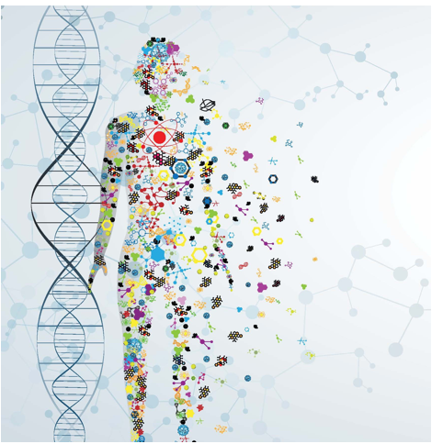
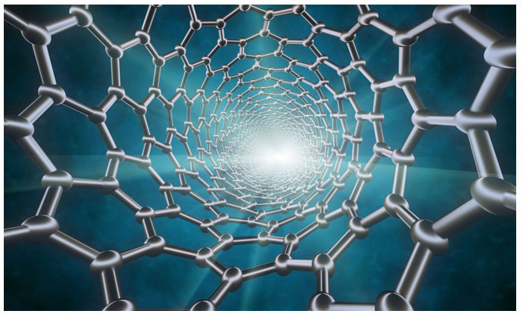
Why Biomedical Engineering?
Precision Medicine
Novel Materials

Slide 4
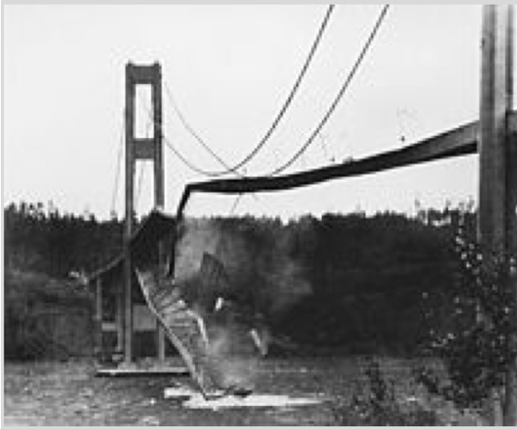
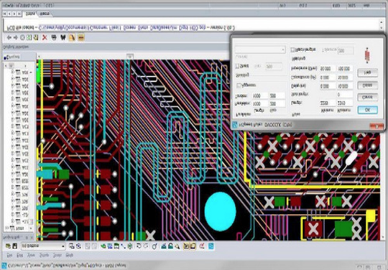
Why Models?
Disasters should occur in silico,
not in vivo.
Emulate experience with hardware design.
(Not knowing about eigenvalues can be disastrous.)

Slide 5
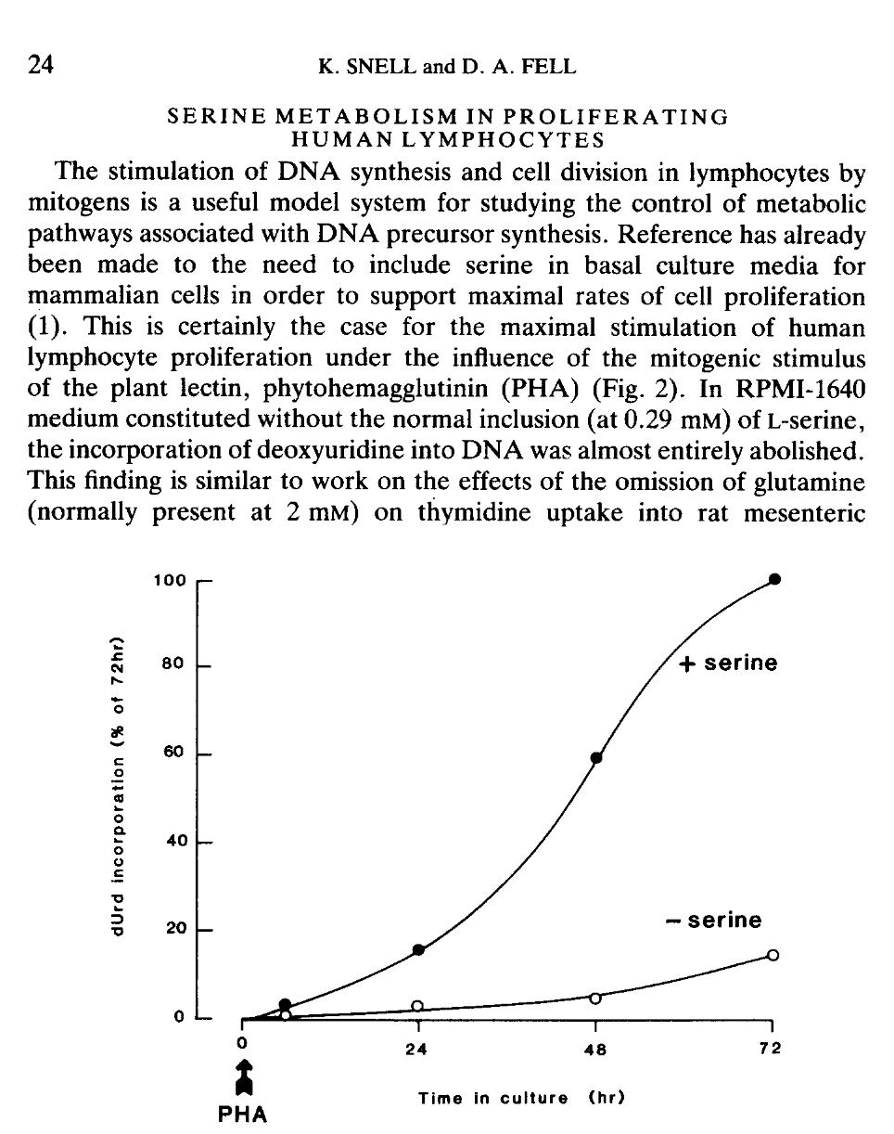
Advances in Enzyme Regulation, 1990.

Slide 6
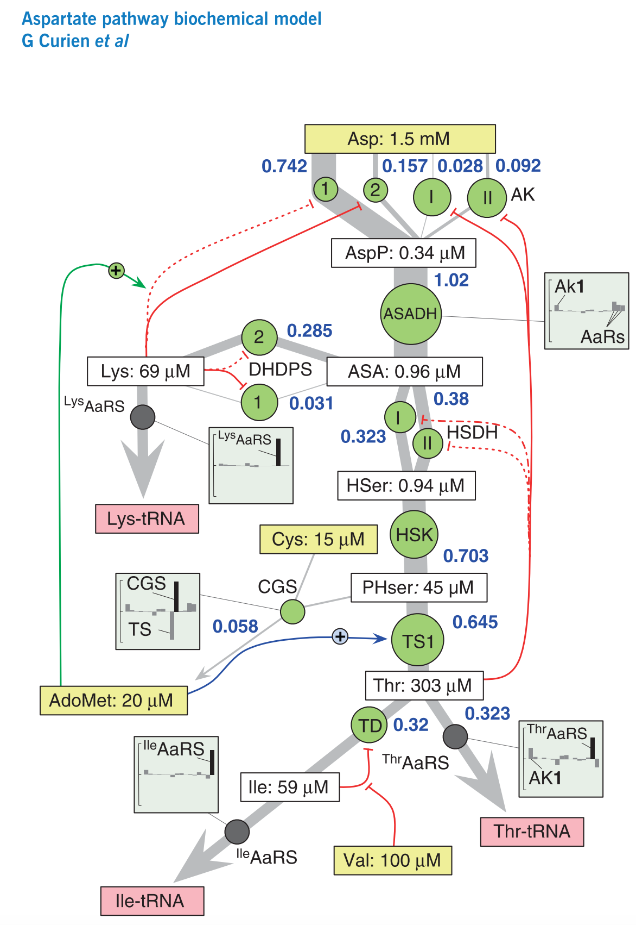
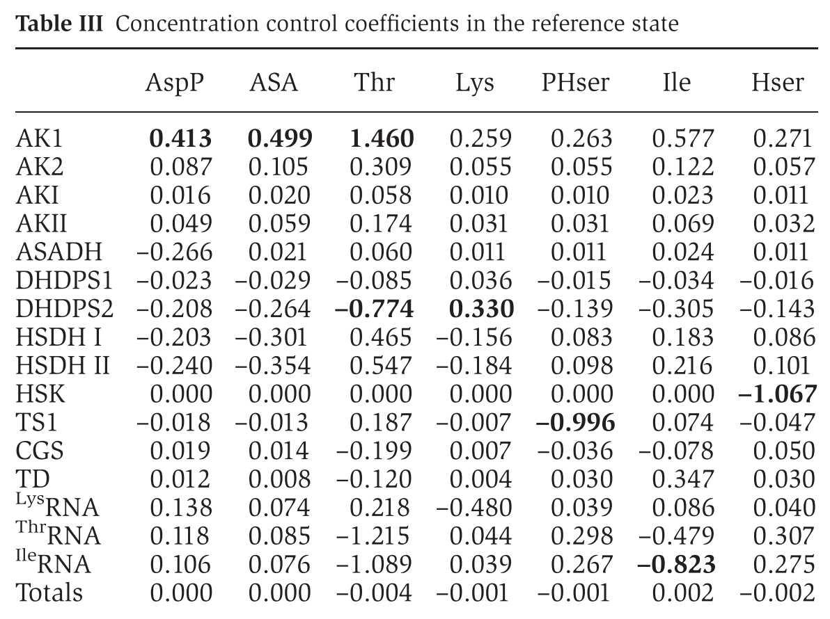
Determining the Impact of Enzymes on Metabolites*
﻿The aspartate-derived amino-acid pathway from plants is well suited for analyzing the function of the allosteric network of interactions in branched pathways. For this purpose, a detailed kinetic model of the system in the plant model Arabidopsis was constructed on the basis of in vitro kinetic measurements.
*Curien et al., Molecular Systems Biology, 2009

Slide 7
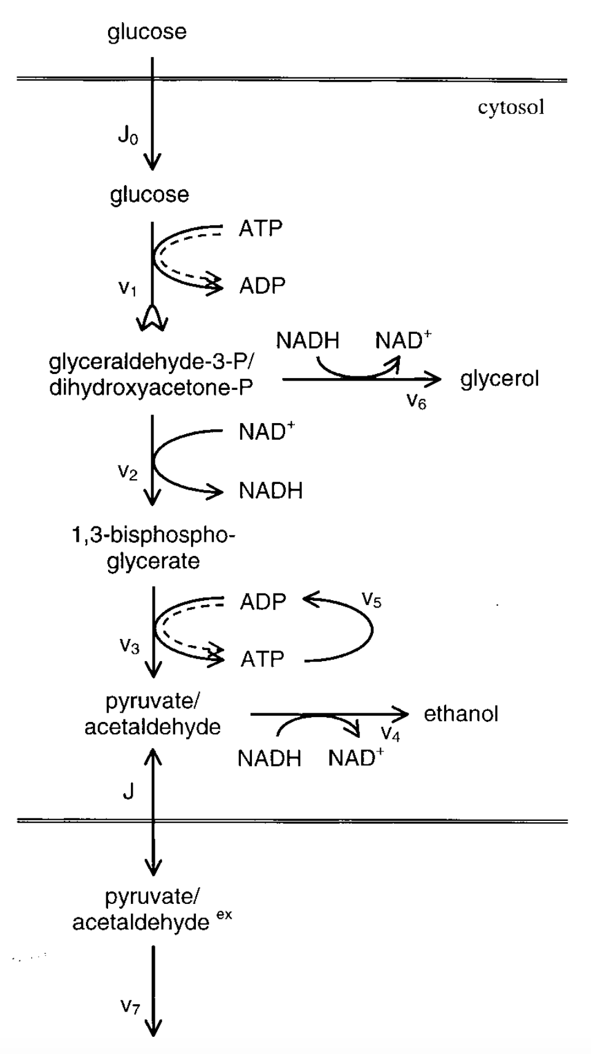
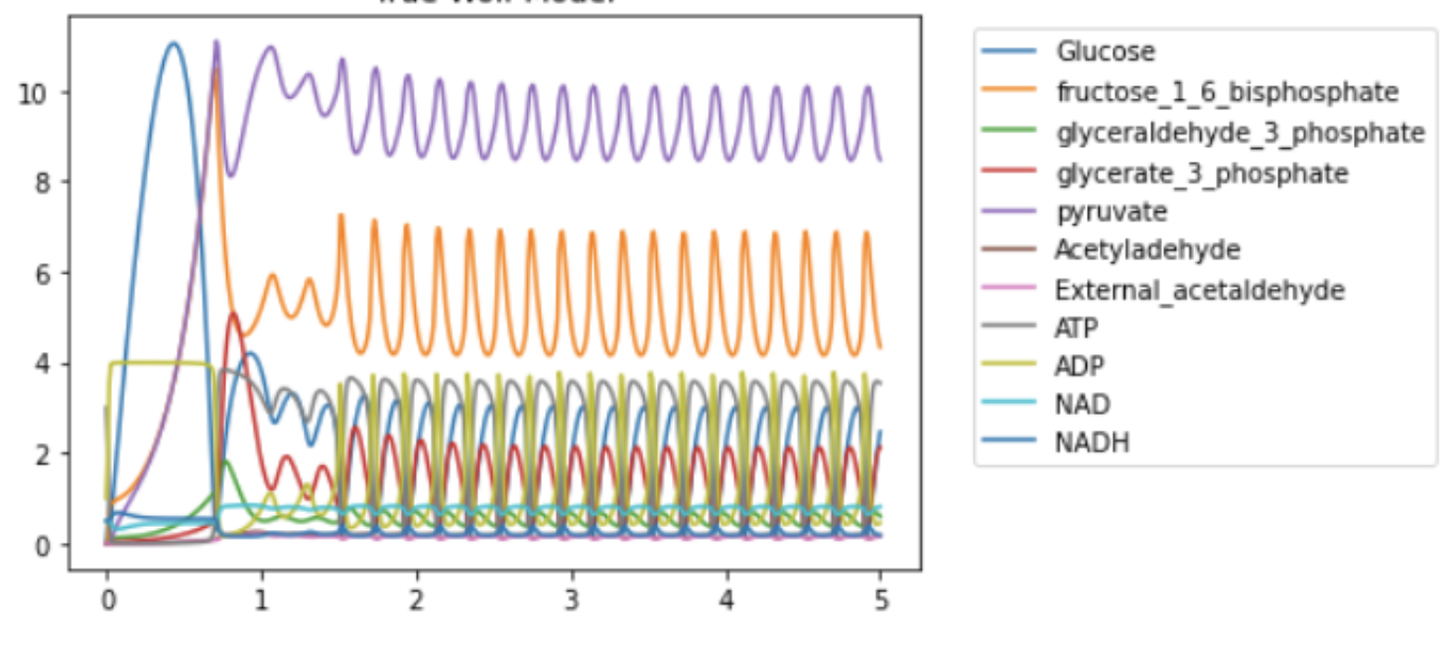
Glycolytic Oscillations in Yeast*
Learning objectives
How develop this model?
What reactions?
What kinetics?
What parameter values?
How evaluate?
How interpret?
*Wolf, J. of Biochem., 2000.

Slide 8
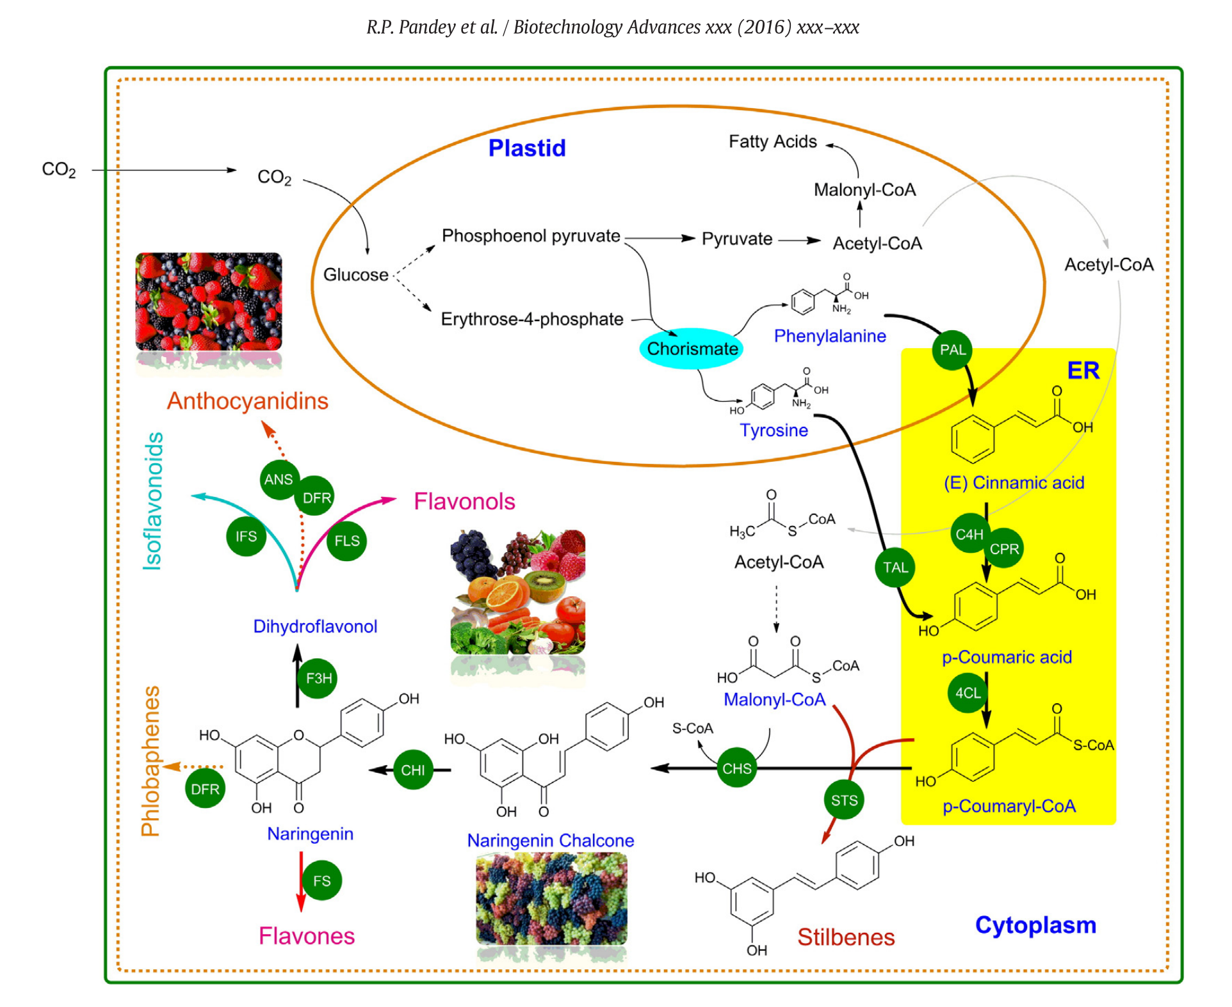
Metabolic Engineering
Model so we can better engineer.

Slide 9
Scientific Goals of Modeling in Biology++
To explain biological processes that result in observed phenomena
To predict previously unobserved phenomena
To identify key generic mechanisms
To guide experiments:
Suggest new experiments
Help interpret experiments
Experiments are limited in number and control, computer simulations can test many more perturbations to explore their consequences
++ James A. Glazier, Biocomplexity Institute Intelligent Systems Engineering, Indiana University, Bloomington, IN

Slide 10
Course Goals
Learn essentials of enzyme kinetics
Develop skills with building quantitative models of biological systems using enzyme kinetics
Skill with using tellurium (and related python packages) to develop reproducible models
Estimate parameters
Estimate parameter uncertainty
Engineering discipline for model development

Slide 11
Instructors
Herbert M Sauro, Associate Professor BIOE
PhD in Systems Biology
Current Research
Dynamics and operation of cellular processes
Clinically reliable approaches to modeling complex systems
Joseph Hellerstein, Senior Fellow eScience Institute, Affiliate Professor CSE
PhD in Computer Science
Industry (30+ years): IBM Research, Microsoft, Google
Mathematical models of distributed computing systems
Research
Modeling evolution of microbial communities
Model Engineering (tools for building biomedical models)

Slide 12
Grading
Undergrads
45% Homework (4)
25% Midterm
30% Software project
Grads
33% Research review
33% Grant proposal
33% Software project

Slide 13
Submitting Homework
You have a folder here. Only you and the instructors have permissions for the folder.
Upload your assignment to the folder before the due date.

Slide 14
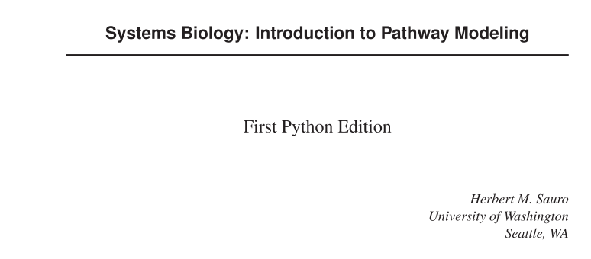
Resources
Text Book
BIOE : https://canvas.uw.edu/courses/1218899/pages/
498a-slash-599-computational-systems-biology-for-medical-applications

Slide 15
Software
The class will feature in-class exercises, so please bring a laptop to class
Software: Tellurium (http://tellurium.analogmachine.org/)
For detailed installation instructions see https://github.com/sys-bio/tellurium#installation-instructions
For a huge database of curated models see:
https://www.ebi.ac.uk/biomodels/
Other packages
Sbstoat – model fitting
SBMLLint – static model verification

Slide 16
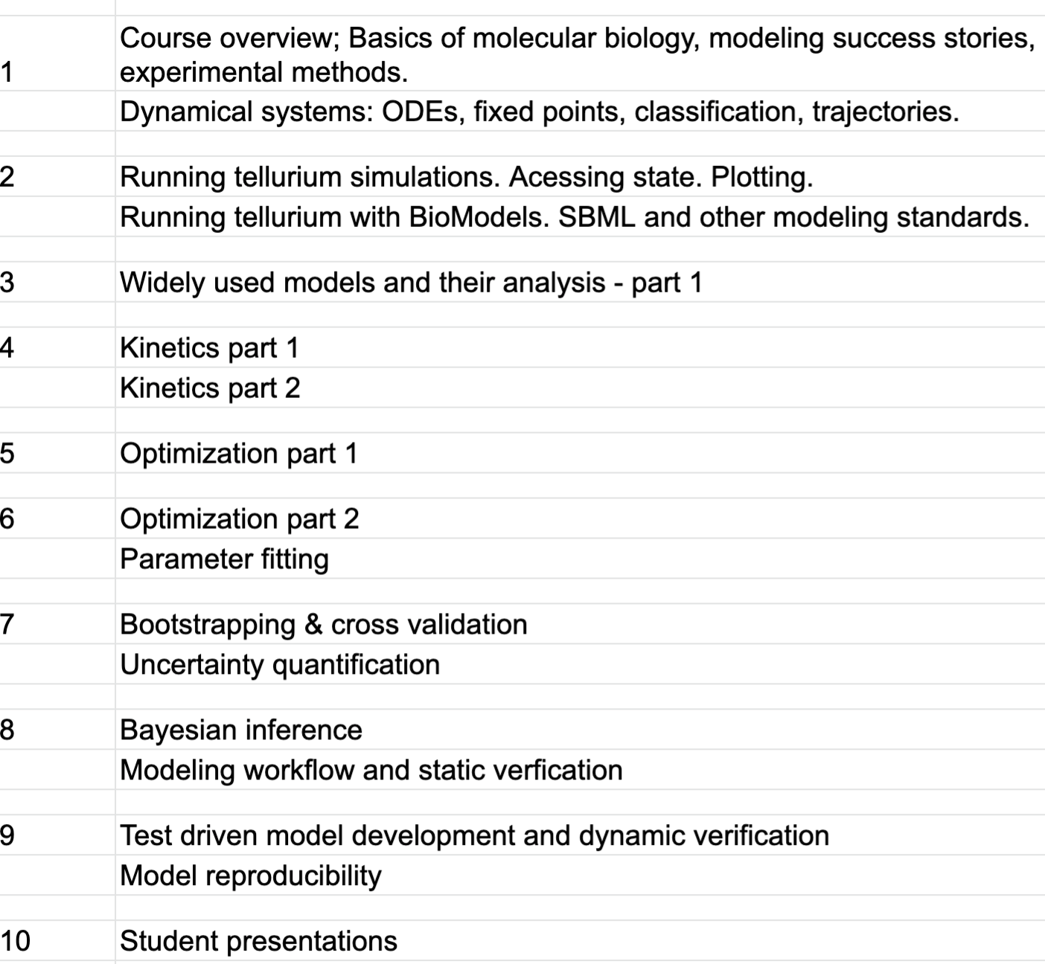
Syllabus

Slide 17
Biochemistry Basics
Molecular biology of cells (highlights)
Enzyme kinetics – a mile high view

Slide 18
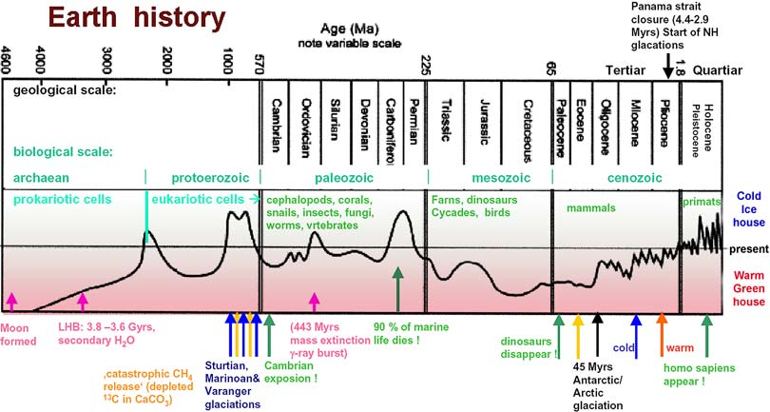
sciencemax.pbworks.com
Notes:
Simple life happened very early, within 0.5B years.
Complex cells took another 2.5B years
After Eukaryotic cells developed, quickly get multi-cellular organisms.

Slide 19
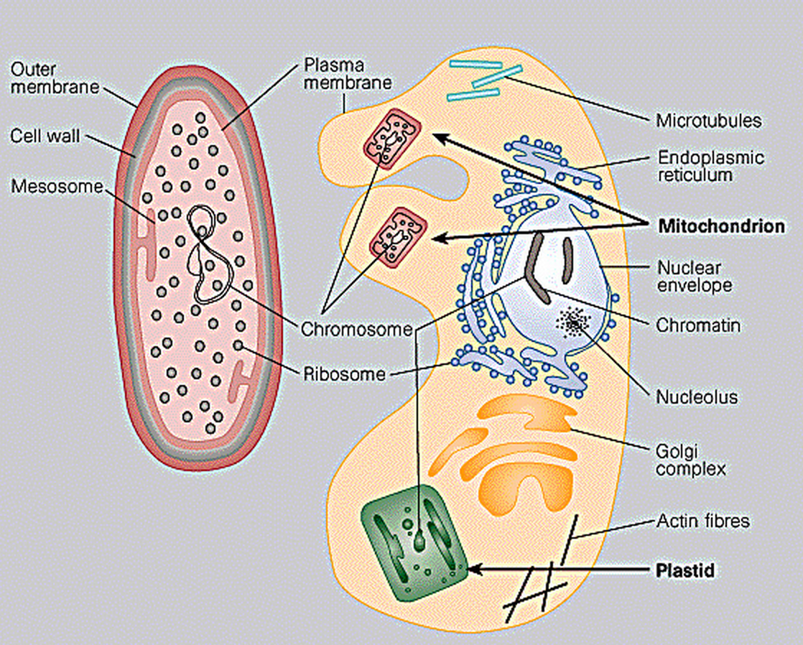
Prokaryotes (3.5B) vs. Eukaryotes (1.5B)
0.2-20 microns
0.2-20 microns
10-100 microns
10-100 microns
Prokaryote
Prokaryote
Eukaryote
Eukaryote

Slide 20
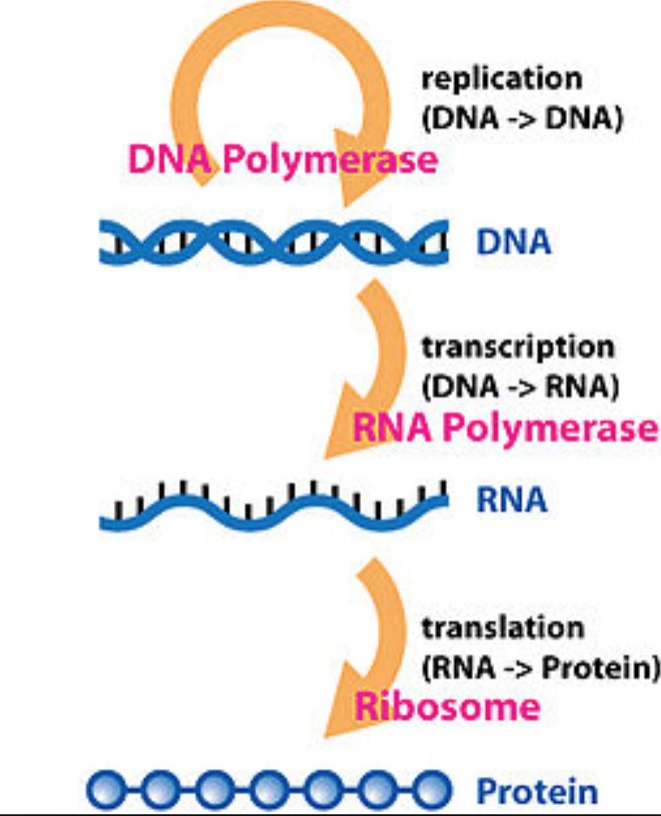
The central dogma relates DNA, RNA, and protein*.
*Wikipedia

Slide 21
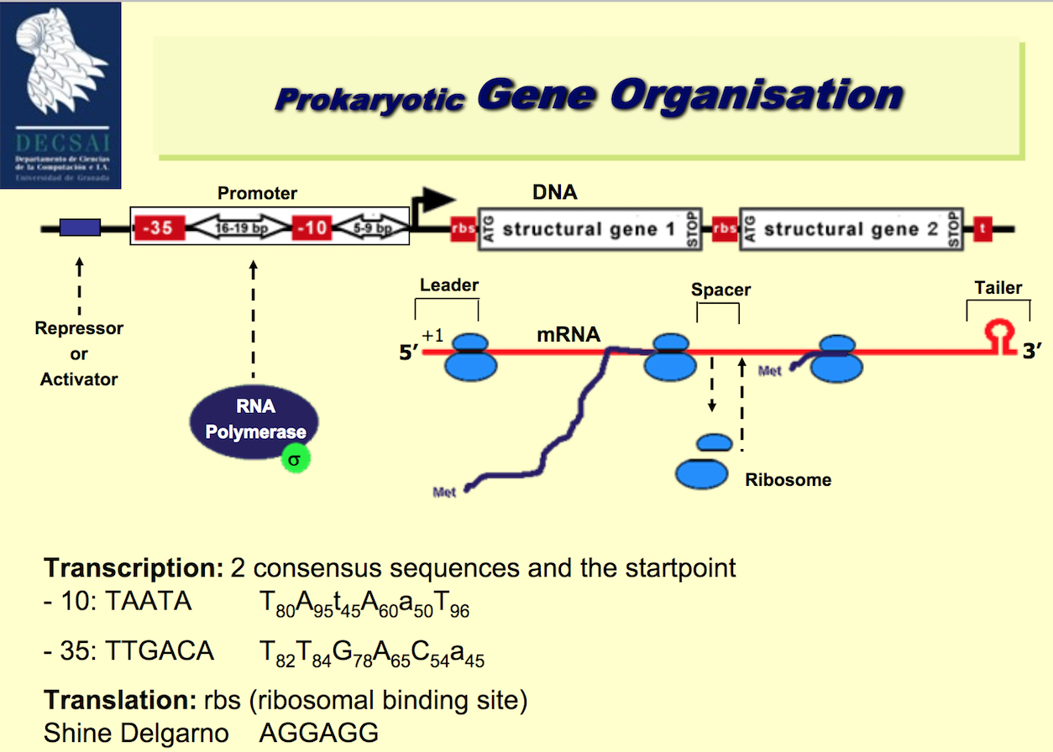

Slide 22
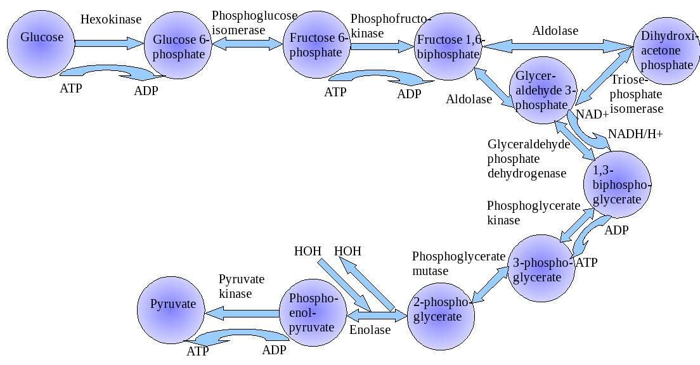
Biochemical Pathway: Collection of Reactions on Biomolecules
Glycolysis
Enzyme – protein that catalyzes a reaction

Slide 23
Enzyme Inhibition

Slide 24
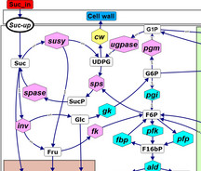
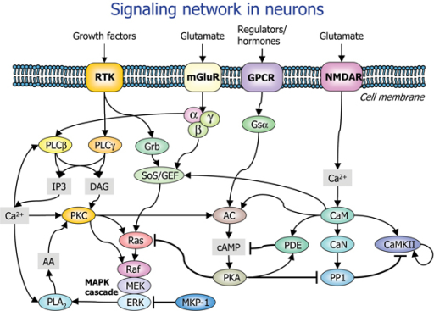
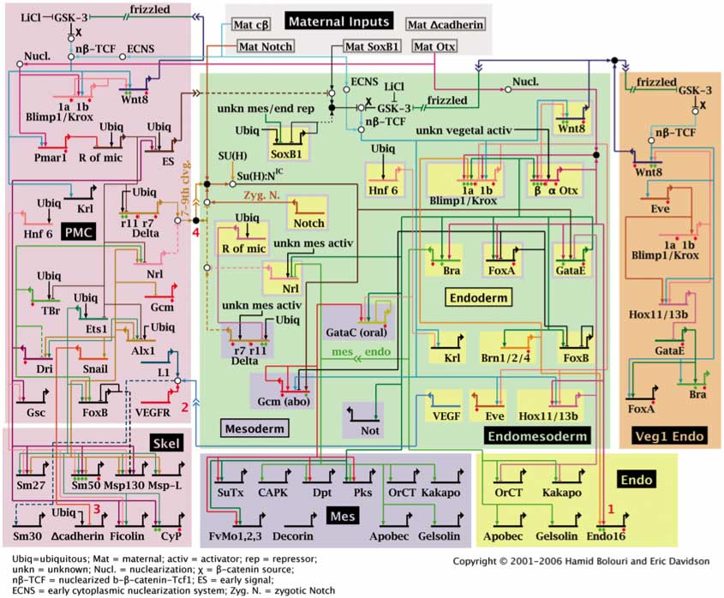
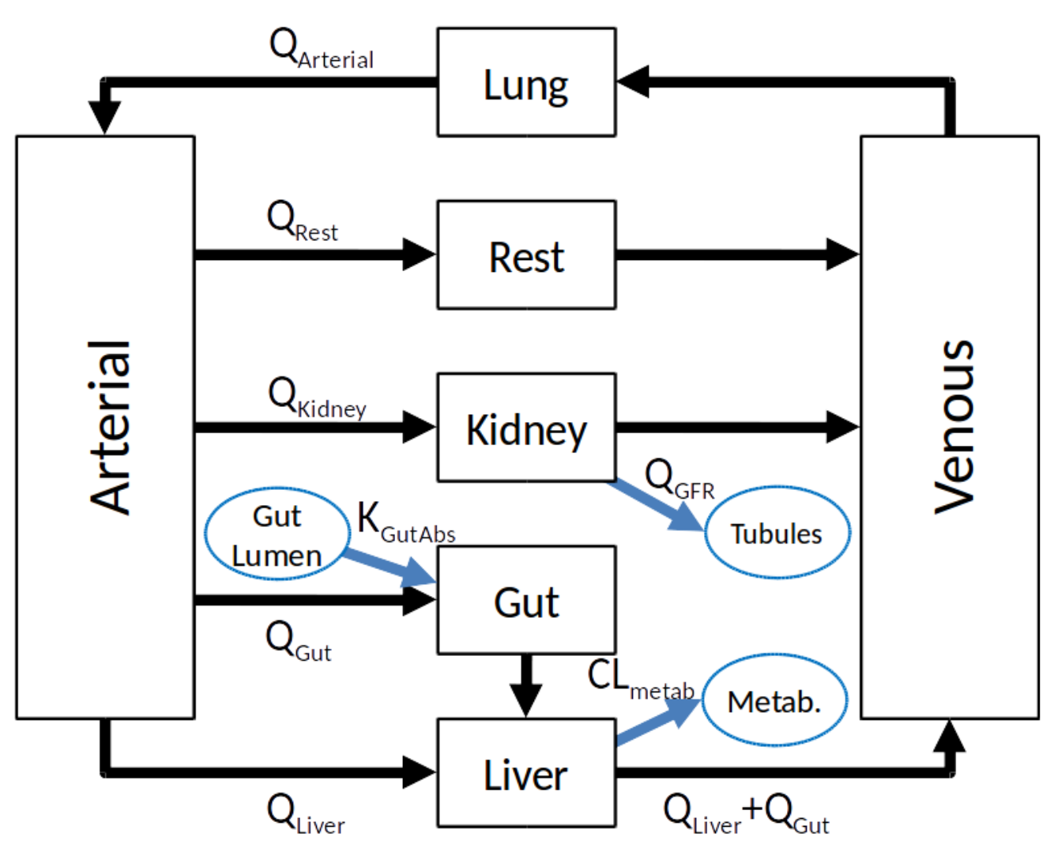
Biological Networks++
Chemical Reaction and Metabolic Networks that create and destroy chemical components of cells and tissues
Signaling Networks that transfer information between and within cells
Regulatory Networks that control the expression of genes and change cell types and behaviors
Physiologically-Based Pharmacokinetic Networks that describe the transport and processing of molecules throughout the body
++ James A. Glazier, Biocomplexity Institute Intelligent Systems Engineering, Indiana University, Bloomington, IN

Slide 25
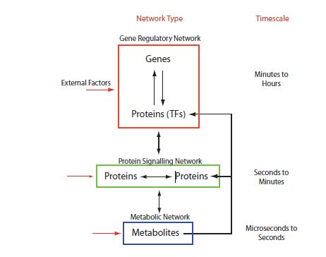
Relationships Between Types of Network++
How does the identity of the active networks in the cell change if we make a controlled change?
How does the states of the cell’s active networks and cell behaviors change if we make a controlled change?
How does the production of cell components and energy change if we make a controlled change?
++ James A. Glazier, Biocomplexity Institute Intelligent Systems Engineering, Indiana University, Bloomington, IN
Notes:
Timescale will be important when we have to simulate two of these at once or if we want to know whether we can assume a signal from one level of network to be constant or equilibrated when we are simulating another scale

Slide 26
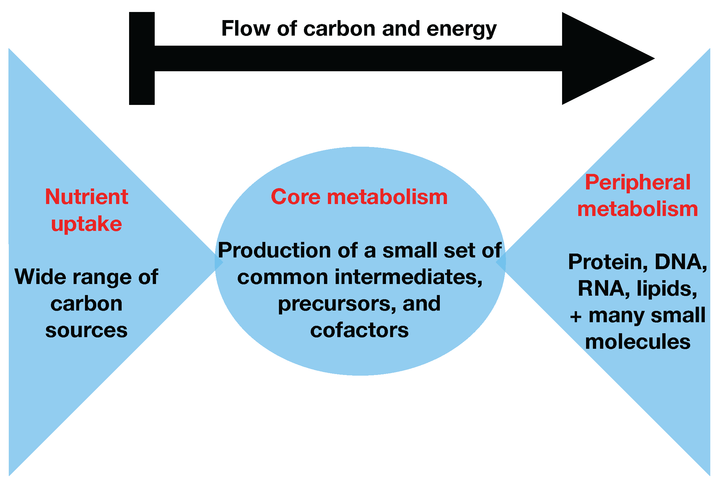
Metabolic Network++
A Metabolic network is a network of chemical reactions in a cell that transforms biomolecules to create energy, create cellular structures, and perform cellular processes.
Digestion of glucose and other nutrients into cellular components and energy production (mostly ATP—adenosine triphosphate and NADH—nicotinamide adenine dinucleotide) are the classic functions of metabolism
++ James A. Glazier, Biocomplexity Institute Intelligent Systems Engineering, Indiana University, Bloomington, IN

Slide 27
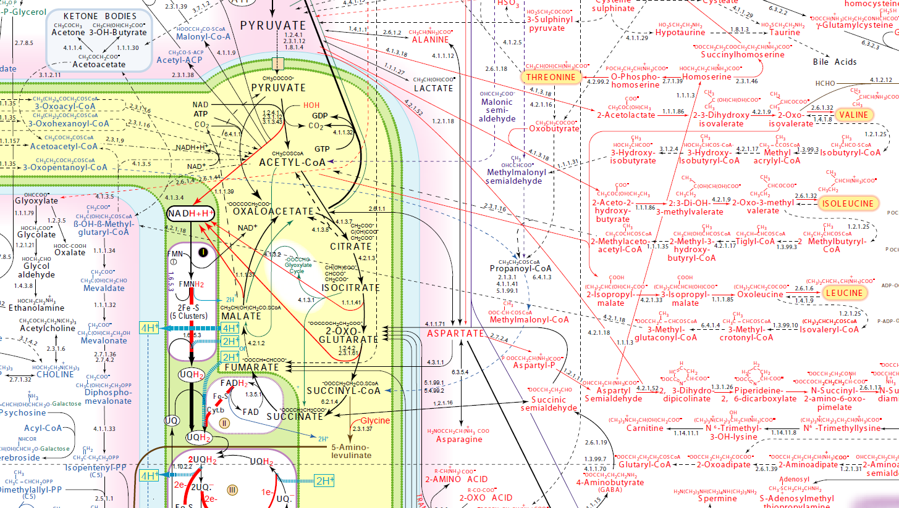
Detailed Metabolic Network
http://www.iubmb-nicholson.org/chart.html

Slide 28
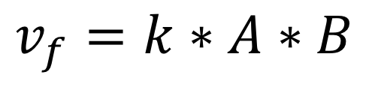
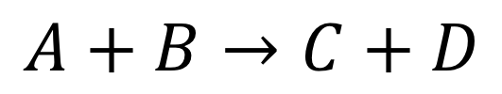
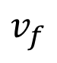
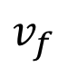
Chemical Kinetics Basics
How fast do reactions go:
Mass action kinetics
Constant times the concentrations of the reactants
$$v_{f}$$
$$v_{f}$$
$$A+B→C+D$$
$$v_{f}=k∗A∗B$$

Slide 29
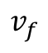
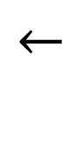
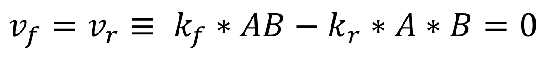
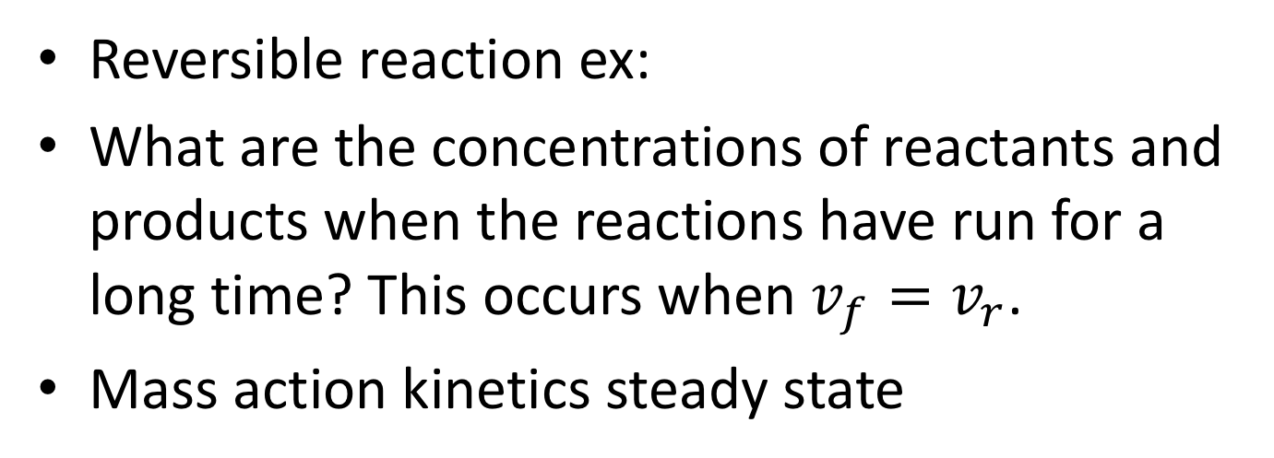
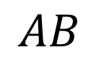
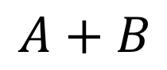
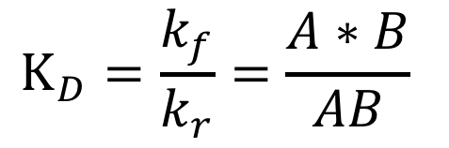
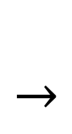
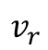
Reversible Reactions & Steady State
$$←$$
$$v_{f}$$
Reversible reaction ex:
What are the concentrations of reactants and products when the reactions have run for a long time? This occurs when $v_{f}=v_{r}$.
Mass action kinetics steady state
$$AB$$
$$←$$
$A+B$
$$v_{r}$$
$$v_{f}=v_{r}≡ k_{f}∗AB−k_{r}∗A∗B=0$$
Disassociation Constant
$$K_{D}=\frac{k_{f}}{k_{r}}=\frac{A∗B}{AB}$$

Slide 30
Biochemical Reactions
Reactant
Molecules
Product
Molecules
Enzyme
But Arcs are often bidirectional
(since chemical reactions can be reversed)
And enzymes may be modified in pathway regulation
(self-modifying code!)
Another Enzyme

Slide 31
Enzymes
Proteins that accelerate biochemical reactions.
Omni-present in biology
Enzymes work by induced fit.

Slide 32
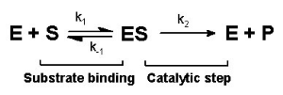
Enzymes and Reaction Kinetics
Notes:
Ask about the rates at each step.

Slide 33
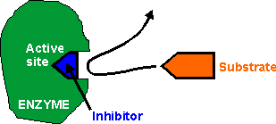
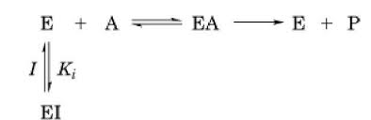
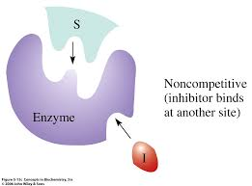
Enzyme Inhibition
Competitive Inhibition
S
ES
Noncompetitive Inhibition

